Slide 1
STROKE PREDICTION
Prepared and presented by:
Julian Cadavid
Vy Tran
Tuan Anh Nguyen
Kewal Tadas

Slide 2
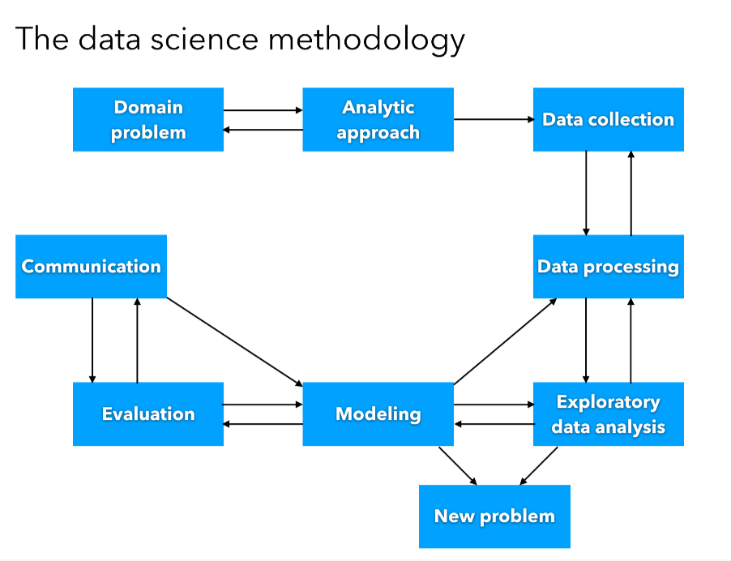

Slide 3
Domain problem
According to the World Health Organization (WHO) stroke is the 2nd leading cause of death globally, responsible for approximately 11% of total deaths. This project is an attempt to build a machine learning model to predict the chances of stroke based on general factors such as underlying health issues and lifestyles.

Slide 4
Data collection & Description.
The Dataset has about 5110 rows of record consists of multiple predictor variables and one of the target variable that is Stroke as Outcome.
Here, as we already have output of the model(Stroke) so it’s a classification model.
Notes:
Hi

Slide 5
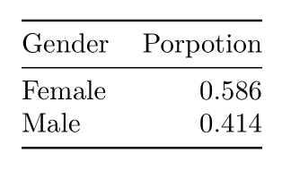
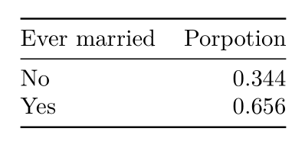
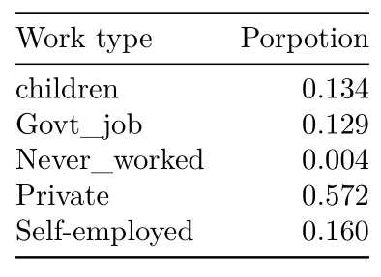
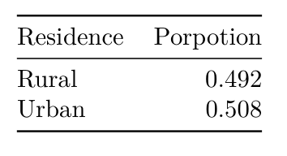
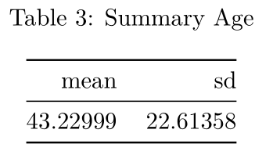
Exploratory Data Analysis

Slide 6
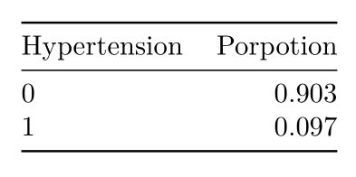
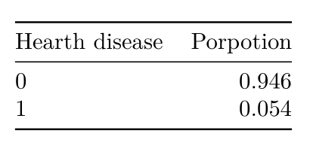
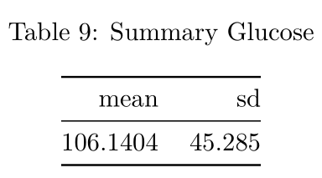
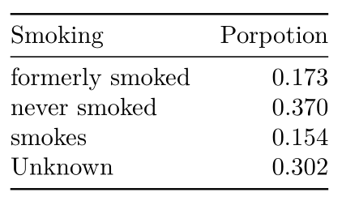
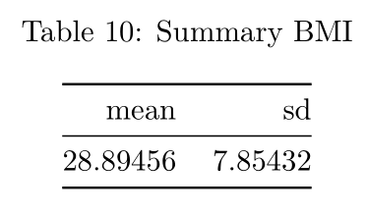
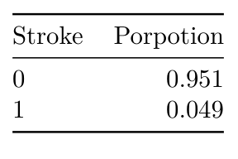
Exploratory Data Analysis

Slide 7
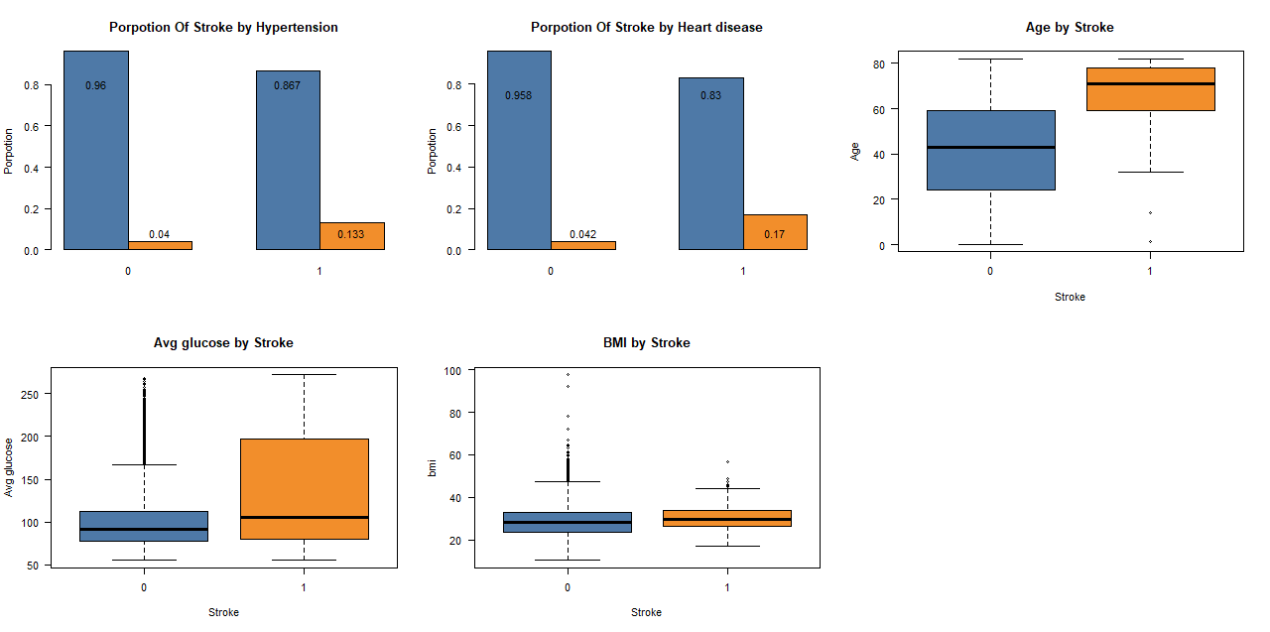
Exploratory Data Analysis

Slide 8
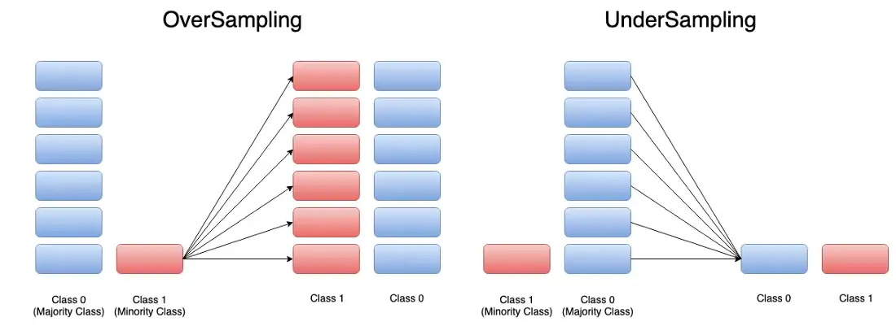

Modeling

Slide 9
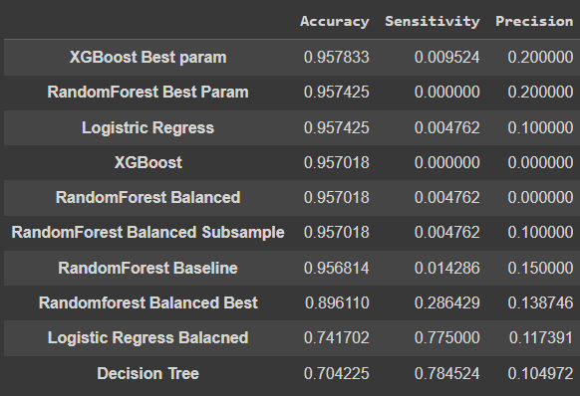
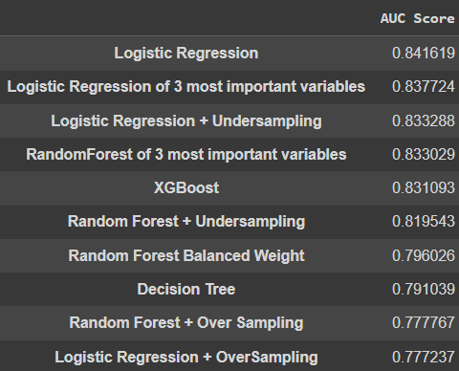
Evaluation and interpretation of model
Model selection
AUC Score
10-fold cross validation or mean Accuracy, Sensitivity and Precision
AUC Score of models with sampling methods and reduced predictors.

Slide 10
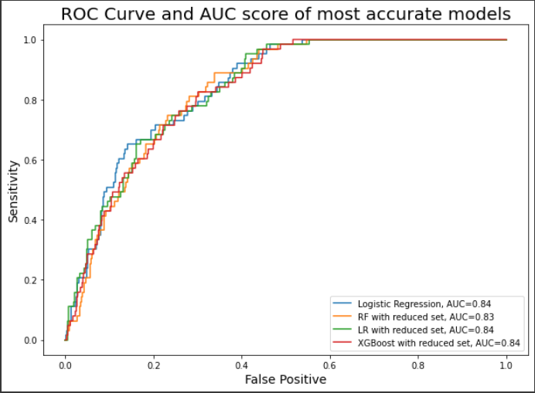
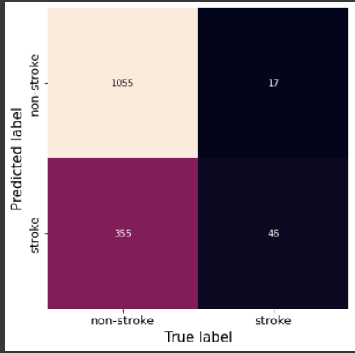
Evaluation (cont.)
ROC curve and AUC score of most accurate models
Logistic Regression with balanced weight classes confusion matrix
Sensitivity: 0.73
Specificity: 0.75
Overall Accuracy: 0.75

Slide 11
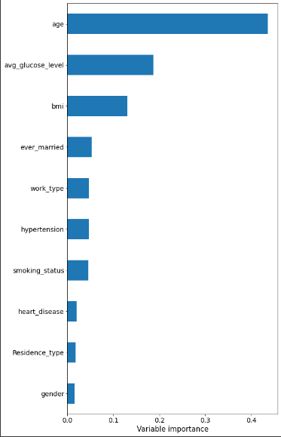
Evaluation (cont.)
Random Forest Variable Importance
Age: 43.5%
Glucose: 18.74%
BMI: 13.05%

Slide 12
Conclusion
3 most important variables for stroke prediction are : Age, Average Glucose Level and BMI which combined predictive power of 75%.
Our Logistic Regression Model have 84% probability to identify people who have stroke (from AUC score).
Describe AGE, BMI, glucose of stroke people.

Slide 13
References
Obermeyer, Z., Powers, B., Vogeli, C. & Mullainathan, S. Science 336, 447–453 (2019).
Bais, Gourav. “How to Handle Imbalance Datasets for Classification Use-Cases.” Medium, Heartbeat, 24 Oct. 2022, https://heartbeat.comet.ml/how-to-handle-imbalance-datasets-for-classification-use-cases-de97806711d.
Mandrekar , Jayawant, et al. “Receiver Operating Characteristic Curve in Diagnostic Test Assessment.” Journal of Thoracic Oncology, Elsevier, 20 Nov. 2015, https://www.sciencedirect.com/science/article/pii/S1556086415306043#:~:text=In%20general%2C%20an%20AUC%20of,than%200.9%20is%20considered%20outstanding.

